Slide 1
Trees
Chapter 11

Slide 2
Chapter Summary
Introduction to Trees
Applications of Trees
Tree Traversal
Spanning Trees
Minimum Spanning

Slide 3
Introduction to Trees
Section 11.1

Slide 4
Section Summary
Introduction to Trees
Rooted Trees
Trees as Models
Properties of Trees

Slide 5
Trees
Definition: A tree is a connected undirected graph with no simple circuits.
Definition: An undirected graph is a tree if and only if there is a unique simple path between any two of its vertices. A tree cannot contain multiple edges or loops.
Definition: An undirected graph is a tree if and only if there is a unique simple path between any two of its vertices.

Slide 6
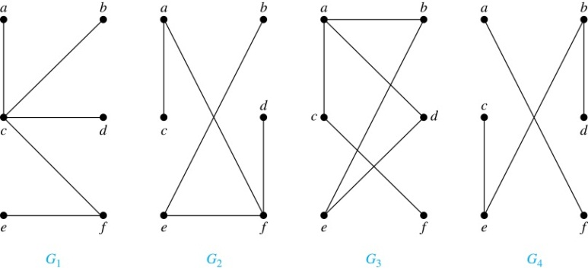
Trees
Example: Which of these graphs are trees?
Solution: G₁ and G₂ are trees - both are connected and have no simple circuits. G₃ is not a tree because e, b, a, d, e is a simple circuit,. G₄ is not a tree because it is not connected.

Slide 7
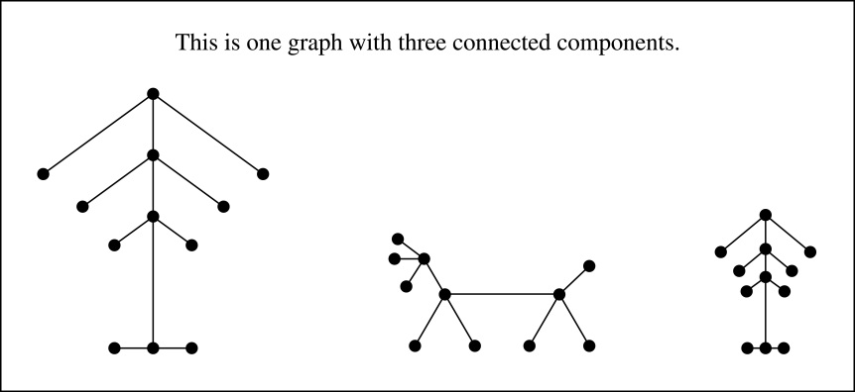
FOREST
Definition: A forest is a graph that has no simple circuit, but is not connected. Each of the connected components in a forest is a tree.

Slide 8
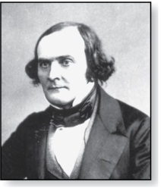
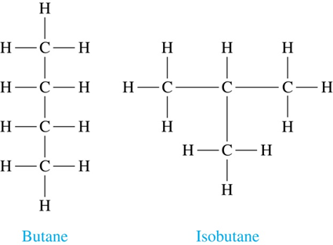
Trees as Models
Arthur Cayley
(1821-1895)
Trees are used as models in computer science, chemistry, geology, botany, psychology, and many other areas.
Trees were introduced by the mathematician Cayley in 1857 in his work counting the number of isomers of saturated hydrocarbons. The two isomers of butane are:.

Slide 9
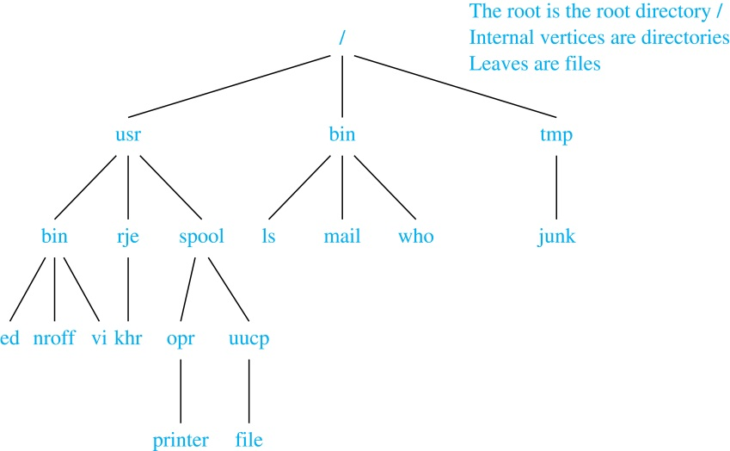
Trees as Models
The organization of a computer file system into directories, subdirectories, and files is naturally represented as a tree.

Slide 10
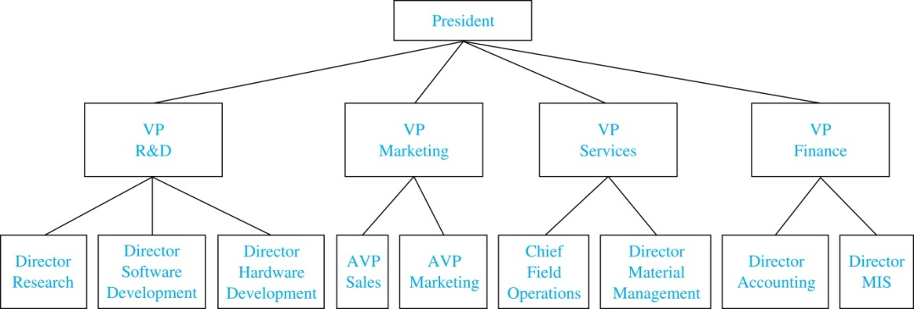
Trees as Models
Trees are used to represent the structure of organizations.

Slide 11
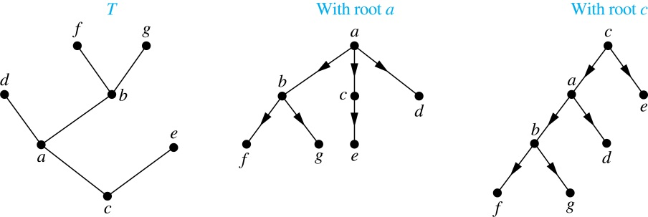
Rooted Trees
Definition: A rooted tree is a tree in which one vertex has been designated as the root and every edge is directed away from the root.
An unrooted tree is converted into different rooted trees when different vertices are chosen as the root.

Slide 12
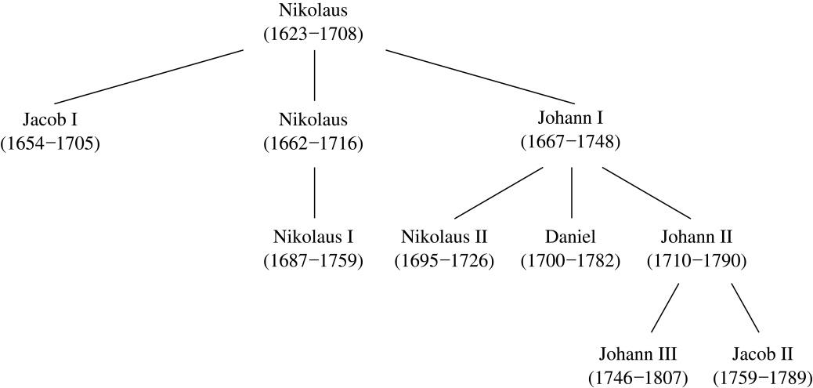
Rooted Tree Terminology
Terminology for rooted trees is a mix from botany and genealogy (such as this family tree of the Bernoulli family of mathematicians).

Slide 13
Rooted Tree Terminology
If v is a vertex of a rooted tree other than the root, the parent of v is the unique vertex u such that there is a directed edge from u to v. When u is a parent of v, v is called a child of u. Vertices with the same parent are called siblings.
The ancestors of a vertex are the vertices in the path from the root to this vertex, excluding the vertex itself and including the root. The descendants of a vertex v are those vertices that have v as an ancestor.
A vertex of a rooted tree with no children is called a leaf. Vertices that have children are called internal vertices.
If a is a vertex in a tree, the subtree with a as its root is the subgraph of the tree consisting of a and its descendants and all edges incident to these descendants.

Slide 14
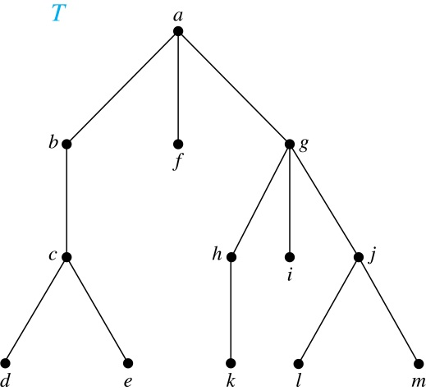
Terminology for Rooted Trees
Example: In the rooted tree T (with root a):
Find the parent of c, the children of g, the siblings of h, the ancestors of e, and the descendants of b.
Solution:
The parent of c is b. The children of g are h, i, and j. The siblings of h are i and j. The ancestors of e are c, b, and a. The descendants of b are c, d, and e.

Slide 15
Terminology for Rooted Trees
Example: In the rooted tree T (with root a):
Find all internal vertices and all leaves.
Solution:
The internal vertices are a, b, c, g, h, and j. The leaves are d, e, f, i, k, l, and m.

Slide 16
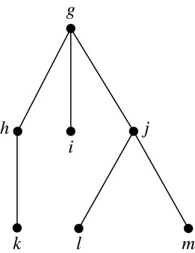
Terminology for Rooted Trees
What is the subtree rooted at G?
Solution:
We display the subtree rooted at g.

Slide 17
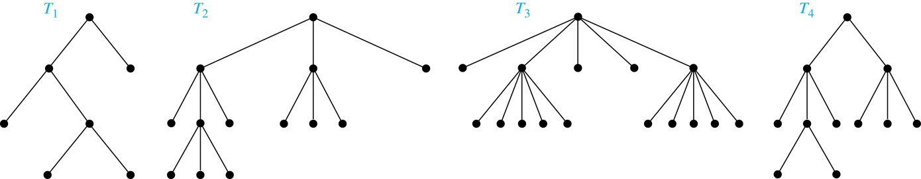
m-ary Rooted Trees
Definition: A rooted tree is called an m-ary tree if every internal vertex has no more than m children. The tree is called a full m-ary tree if every internal vertex has exactly m children. An m-ary tree with m = 2 is called a binary tree.
Example: Are the following rooted trees full m-ary trees for some positive integer m?

Slide 18
Solution:
T₁ is a full binary tree because each of its internal vertices has two children.
T₂ is a full 3-ary tree because each of its internal vertices has three children.
In T₃ each internal vertex has five children, so T₃ is a full 5-ary tree.
T₄ is not a full m-ary tree for any m because some of its internal vertices have two children and others have three children.

Slide 19
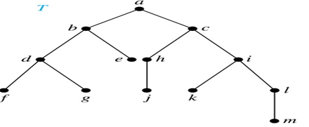
Ordered Rooted Trees
Definition: An ordered rooted tree is a rooted tree where the children of each internal vertex are ordered.
We draw ordered rooted trees so that the children of each internal vertex are shown in order from left to right.

Slide 20
Binary Trees
Definition: A binary tree is an ordered rooted where each internal vertex has at most two children. If an internal vertex of a binary tree has two children, the first is called the left child and the second the right child. The tree rooted at the left child of a vertex is called the left subtree of this vertex, and the tree rooted at the right child of a vertex is called the right subtree of this vertex.

Slide 21
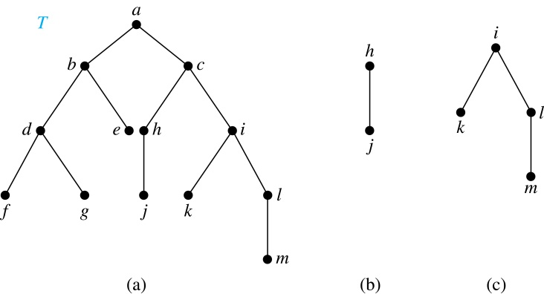
Example:
Consider the binary tree T.
(i) What are the left and right children of d?
(ii) What are the left and right subtrees of c?
Solution:
(i) The left child of d is f and the right child is g.
(ii) The left and right subtrees of c are displayed in (b) and (c).

Slide 22
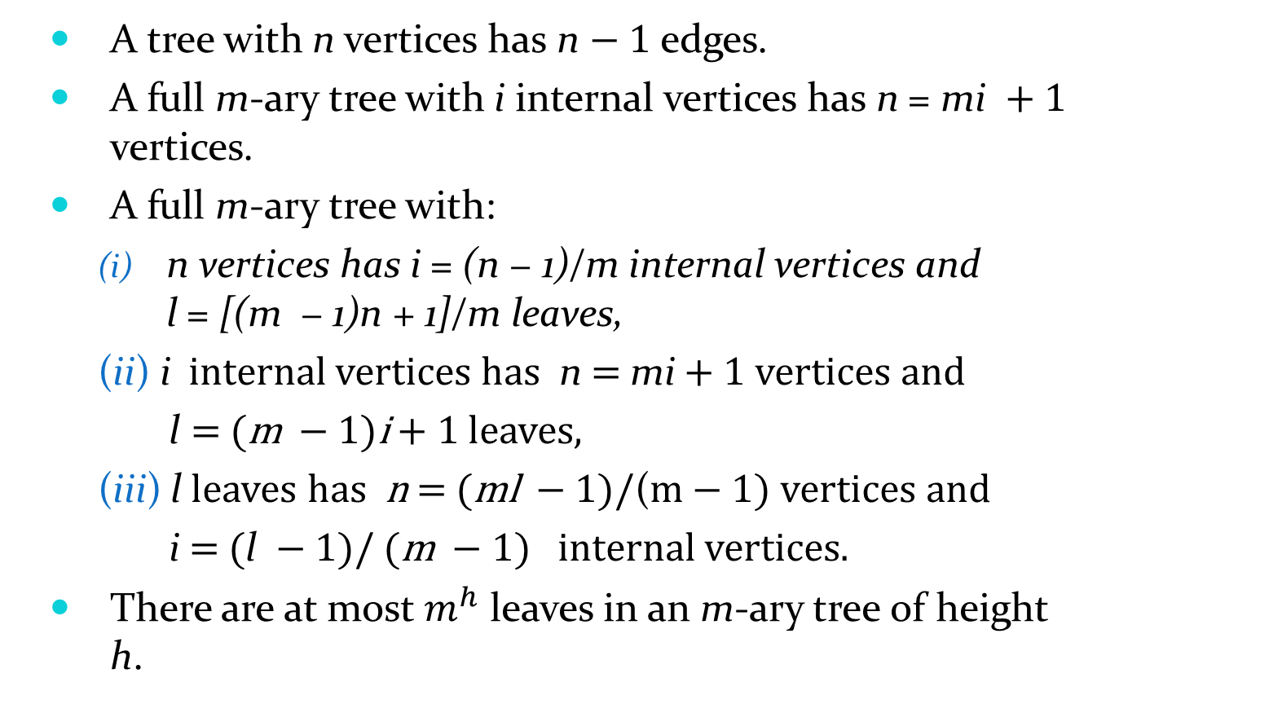
Properties of Trees
A tree with n vertices has n − 1 edges.
A full m-ary tree with i internal vertices has n = mi + 1 vertices.
A full m-ary tree with:
n vertices has i = (n − 1)/m internal vertices and l = [(m − 1)n + 1]/m leaves,
(ii) i internal vertices has n = mi + 1 vertices and
l = (m − 1)i + 1 leaves,
(iii) l leaves has n = (ml − 1)/(m − 1) vertices and
i = (l − 1)/ (m − 1) internal vertices.
There are at most $m^{h}$ leaves in an m-ary tree of height h.

Slide 23
Level of vertices and height of trees
When working with trees, we often want to have rooted trees where the subtrees at each vertex contain paths of approximately the same length.
To make this idea precise we need some definitions:
The level of a vertex v in a rooted tree is the length of the unique path from the root to this vertex.
The height of a rooted tree is the maximum of the levels of the vertices.

Slide 24
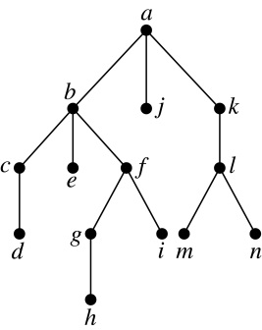
Level of vertices and height of trees
Example:
(i) Find the level of each vertex in
the tree to the right.
(ii) What is the height of the tree?
Solution:
(i) The root a is at level 0.
Vertices b, j, and k are at level 1.
Vertices c, e, f, and l are at level 2.
Vertices d, g, i, m, and n are at level 3.
Vertex h is at level 4.
(ii) The height is 4, since 4 is the largest level of any vertex.

Slide 25
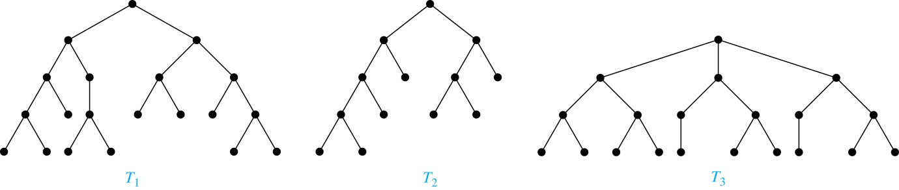
Balanced m-Ary Trees
Definition: A rooted m-ary tree of height h is balanced if all leaves are at levels h or h − 1.
Example: Which of the rooted trees shown below is balanced?
Solution: T₁ and T₃ are balanced, but T₂ is not because it has leaves at levels 2, 3, and 4.

Slide 26
Applications of Trees
Section 11.2

Slide 27
Binary Search Tree
Definition: A binary tree in which the vertices are labeled with items so that a label of a vertex is greater than the labels of all vertices in the left subtree of this vertex and is less than the labels of all vertices in the right subtree of this vertex.
Searching for items in a list is one of the most important tasks that arises in computer science.
Our primary goal is to implement a searching algorithm that finds items efficiently when the items are totally ordered. This can be accomplished through the use of a binary search tree

Slide 28
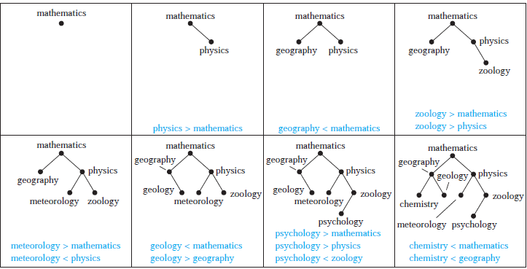
Example : Form a binary search tree for the words mathematics, physics, geography, zoology, meteorology, geology, psychology, and chemistry (using alphabetical order).

Slide 29
Decision Trees
Definition: A rooted tree where each vertex represents a possible outcome of a decision and the leaves represent the possible solutions of a problem.
Rooted trees can be used to model problems in which a series of decisions leads to a solution.
The possible solutions of the problem correspond to the paths to the leaves of this rooted tree.

Slide 30
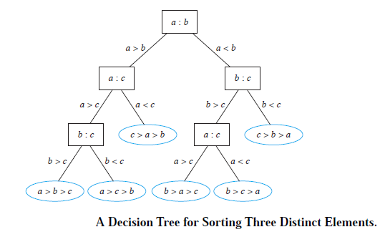
Example : A decision tree that orders the elements of the list a, b, c.

Slide 31
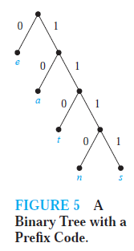
Prefix code
Definition: A code that has the property that the code of a character is never a prefix of the code of another character.
A prefix code can be represented using a binary tree, where the characters are the labels of the leaves in the tree.
The edges of the tree are labeled so that an edge leading to a left child is assigned a 0 and an edge leading to a right child is assigned a 1.
The bit string used to encode a character is the sequence of labels of the edges in the unique path from the root to the leaf that has this character as its label.
For instance, the tree in Figure 5 represents the encoding of e by 0, a by 10, t by 110, n by 1110, and s by 1111.

Slide 32
Applications of Trees
Game Trees
Trees can be used to analyze certain types of games such as tic-tac-toe, nim, checkers, and chess.

Slide 33
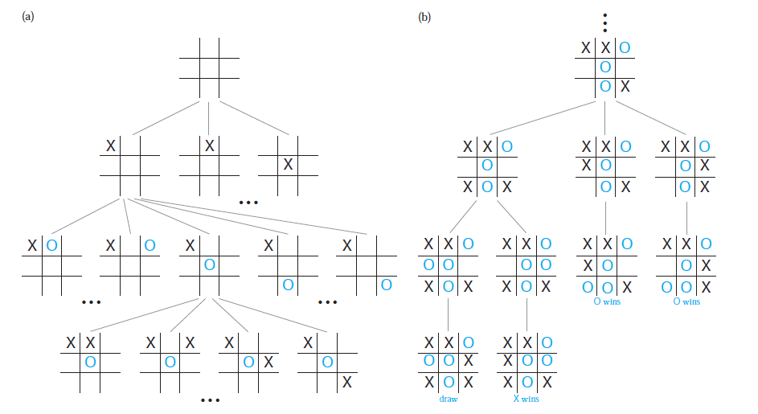
Game Tree for Tic-Tac-Toe

Slide 34
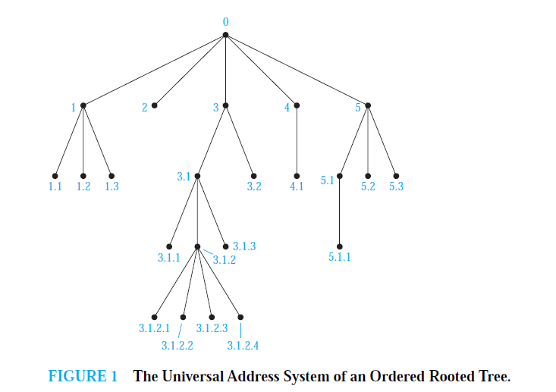
Universal Address Systems

Slide 35
Tree Traversal
Section 11.3

Slide 36
Tree Traversal
Procedures for systematically visiting every vertex of an ordered tree are called traversals.
The three most commonly used traversals are preorder traversal, inorder traversal, and postorder traversal.

Slide 37
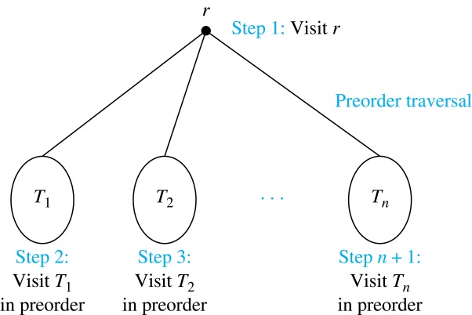
Preorder Traversal
Definition: Let T be an ordered rooted tree with root r. If T consists only of r, then r is the preorder traversal of T. Otherwise, suppose that T₁, T₂, …, T_{n} are the subtrees of r from left to right in T. The preorder traversal begins by visiting r, and continues by traversing T₁ in preorder, then T₂ in preorder, and so on, until T_{n} is traversed in preorder.

Slide 38
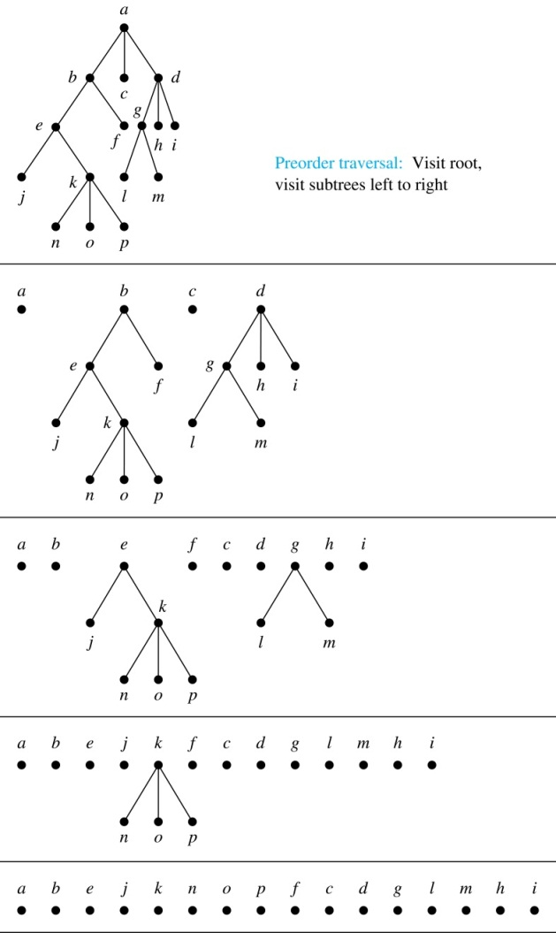
Preorder Traversal (continued)
procedure preorder (T: ordered rooted tree)
r := root of T
list r
for each child c of r from left to right
T(c) := subtree with c as root
preorder(T(c))

Slide 39
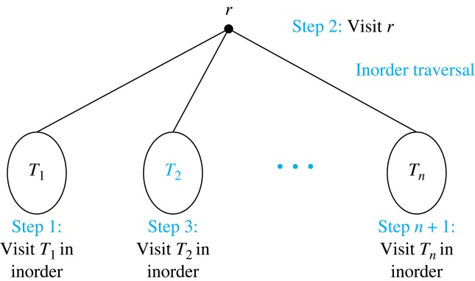
Inorder Traversal
Definition: Let T be an ordered rooted tree with root r. If T consists only of r, then r is the inorder traversal of T. Otherwise, suppose that T₁, T₂, …, T_{n} are the subtrees of r from left to right in T. The inorder traversal begins by traversing T₁ in inorder, then visiting r, and continues by traversing T₂ in inorder, and so on, until T_{n} is traversed in inorder.

Slide 40
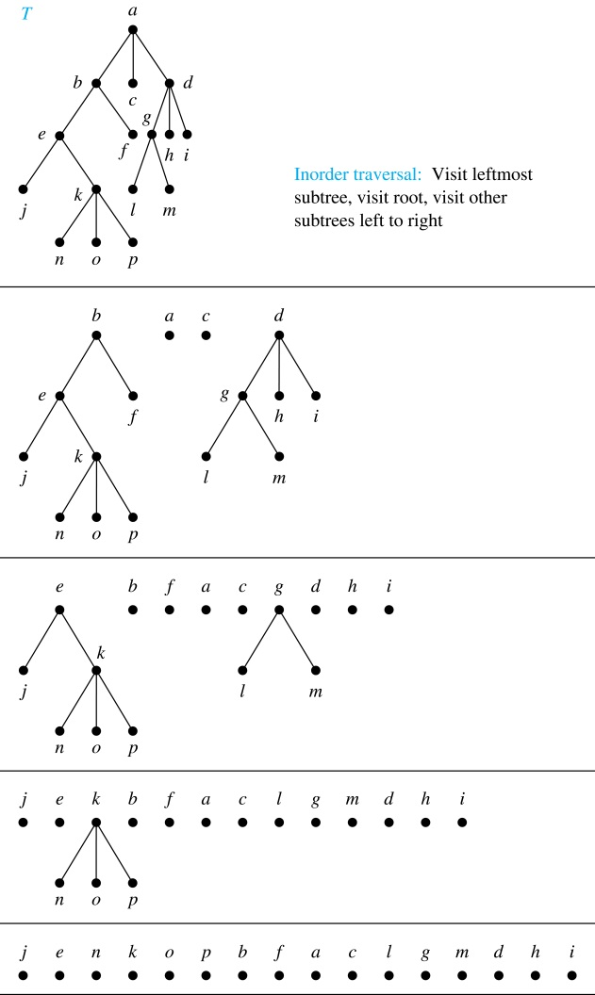
Inorder Traversal (continued)
procedure
inorder (T: ordered rooted tree)
r := root of T
if r is a leaf then list r
else
l := first child of r from left to right
T(l) := subtree with l as its root
inorder(T(l))
list(r)
for each child c of r from left to right
T(c) := subtree with c as root
inorder(T(c))

Slide 41
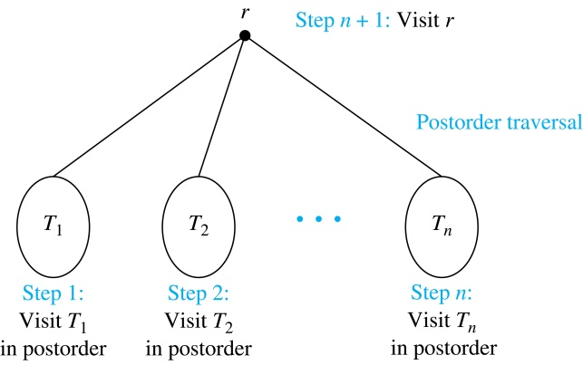
Postorder Traversal
Definition: Let T be an ordered rooted tree with root r. If T consists only of r, then r is the postorder traversal of T. Otherwise, suppose that T₁, T₂, …, T_{n} are the subtrees of r from left to right in T. The postorder traversal begins by traversing T₁ in postorder, then T₂ in postorder, and so on, after T_{n} is traversed in postorder, r is visited.

Slide 42
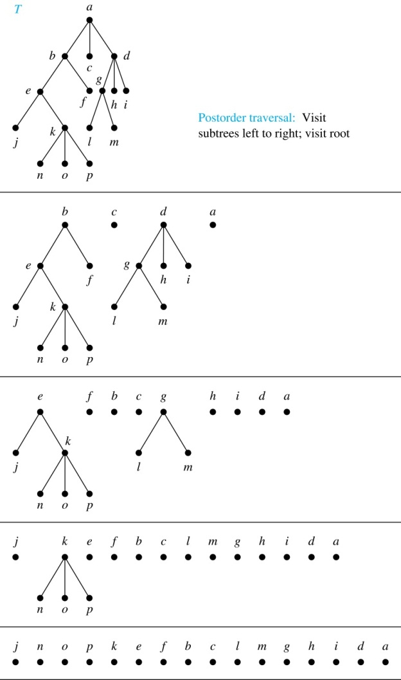
Postorder Traversal (continued)
procedure postordered (T: ordered rooted tree)
r := root of T
for each child c of r from left to right
T(c) := subtree with c as root
postorder(T(c))
list r

Slide 43
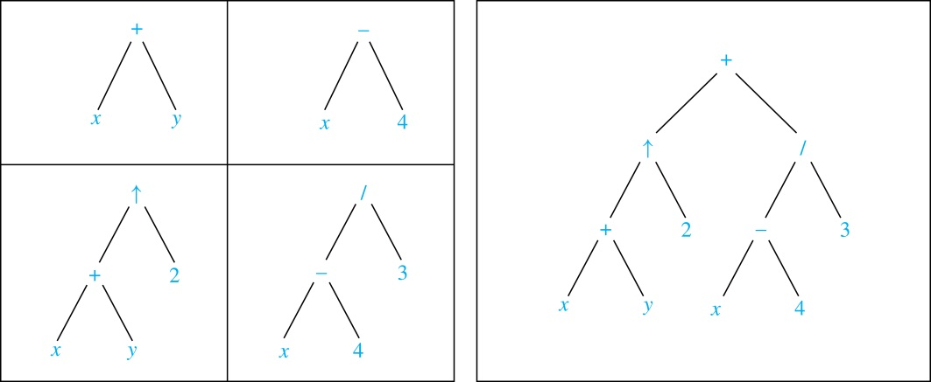
Expression Trees
Complex expressions can be represented using ordered rooted trees.
Consider the expression ((x + y) ↑ 2 ) + ((x − 4)/3).
A binary tree for the expression can be built from the bottom up, as is illustrated here.

Slide 44
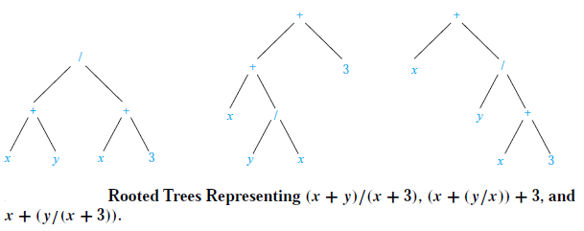
Infix Notation
An inorder traversal of the tree representing an expression produces the original expression when parentheses are included except for unary operations, which now immediately follow their operands.
We illustrate why parentheses are needed with an example that displays three trees all yield the same infix representation.

Slide 45
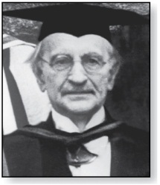
Prefix Notation
Jan Łukasiewicz (1878-1956)
When we traverse the rooted tree representation of an expression in preorder, we obtain the prefix form of the expression. Expressions in prefix form are said to be in Polish notation, named after the Polish logician Jan Łukasiewicz.
Operators precede their operands in the prefix form of an expression. Parentheses are not needed as the representation is unambiguous.
The prefix form of ((x + y) ↑ 2 ) + ((x − 4)/3)
is + ↑ + x y 2 / − x 4 3.
Prefix expressions are evaluated by working from right to left. When we encounter an operator, we perform the corresponding operation with the two operations to the right.

Slide 46
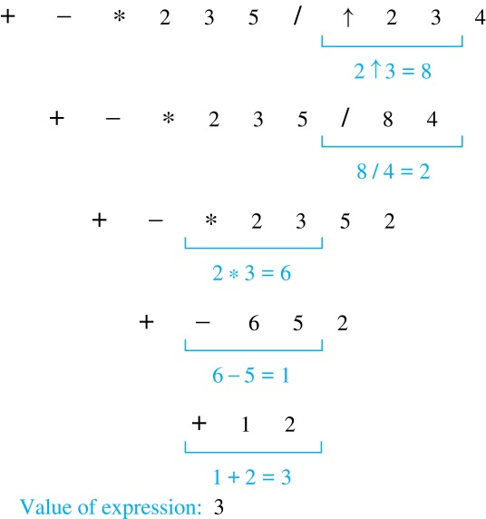
Prefix Notation
Example: We show the steps used to evaluate a particular prefix expression:

Slide 47
Postfix Notation
We obtain the postfix form of an expression by traversing its binary trees in postorder. Expressions written in postfix form are said to be in reverse Polish notation.
Parentheses are not needed as the postfix form is unambiguous.
x y + 2 ↑ x 4 − 3 / + is the postfix form of ((x + y) ↑ 2 ) + ((x − 4)/3).
A binary operator follows its two operands. So, to evaluate an expression one works from left to right, carrying out an operation represented by an operator on its preceding operands.

Slide 48
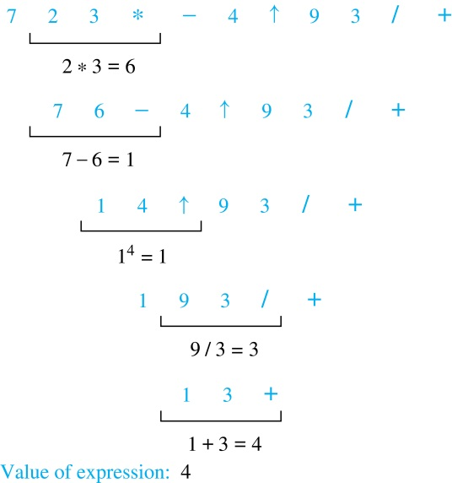
Postfix Notation
Example: We show the steps used to evaluate a particular postfix expression.

Slide 49
Spanning Trees
Section 11.4

Slide 50
Section Summary
Spanning Trees
Prim’s Algorithm
Kruskal Algorithm

Slide 51
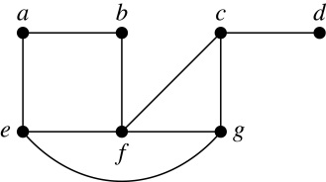
Spanning Trees
Definition: Let G be a simple graph. A spanning tree of G is a subgraph of G that is a tree containing every vertex of G.
Example: Find the spanning tree of the simple graph:

Slide 52
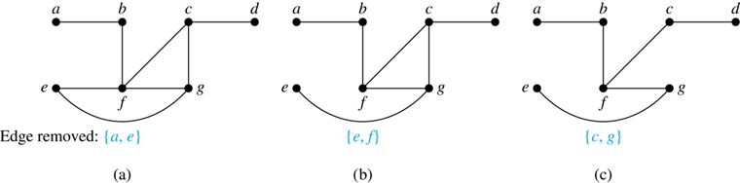
Spanning Trees
Solution: The graph is connected, but is not a tree because it contains simple circuits. Remove the edge {a, e}. Now one simple circuit is gone, but the remaining subgraph still has a simple circuit. Remove the edge {e, f} and then the edge {c, g} to produce a simple graph with no simple circuits. It is a spanning tree, because it contains every vertex of the original graph.

Slide 53
Minimum Spanning
Section 11.5

Slide 54
Minimum spanning tree
A minimum spanning tree in a connected weighted graph is a spanning tree that has the smallest possible sum of weights of its edges.
Example: A company plans to build a communications network connecting its five computer centers. Any pair of these centers can be linked with a leased telephone line. Which links should be made to ensure that there is a path between any two computer centers so that the total cost of the network is minimized?

Slide 55
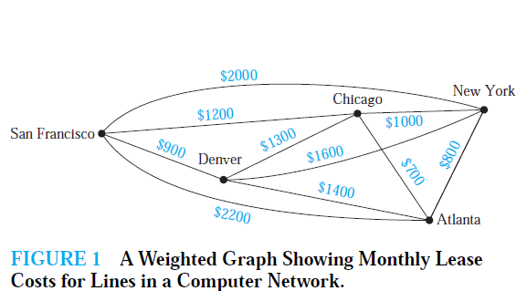
Minimum spanning tree
Solution: We can model this problem using the weighted graph shown in Figure 1, where vertices represent computer centers, edges represent possible leased lines, and the weights on edges are the monthly lease rates of the lines represented by the edges. We can solve this problem by finding a spanning tree so that the sum of the weights of the edges of the tree is minimized. Such a spanning tree is called a minimum spanning tree.

Slide 56
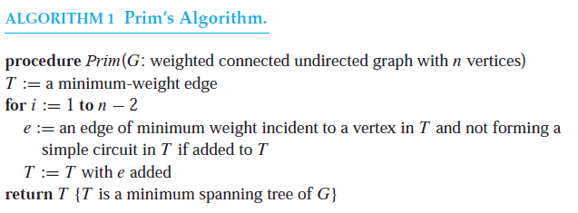
PRIM’S ALGORITHM

Slide 57
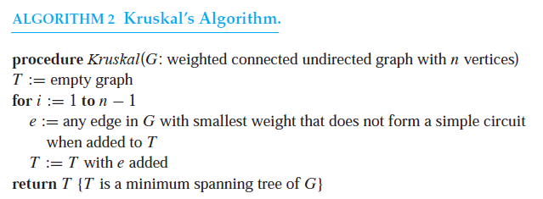
KRUSKAL’S ALGORITHM

Slide 58
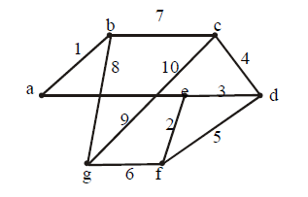
Minimal spanning tree (MST)
Example: Use Kruskal’s and Prims algorithm to find a minimal spanning tree for the graph below. Indicate the order in which edges are added to form the tree.

Slide 59
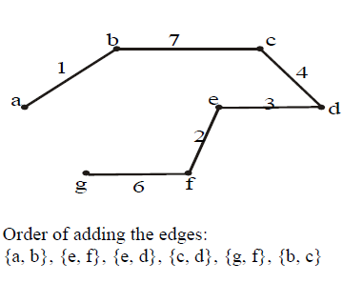
SOLUTION:

Slide 60
Counting
Chapter 6
Mr. Shoaib Raza

Slide 61
Chapter Summary
The Basics of Counting
The Pigeonhole Principle
Permutations and Combinations
Binomial Coefficients and Identities
Generalized Permutations and Combinations

Slide 62
The Basics of Counting
Section 6.1

Slide 63
COMBINATORICS
Combinatorics is the mathematics of counting and arranging objects. Counting of objects with certain properties (enumeration) is required to solve many different types of problem.
Applications, include topics as diverse as codes, circuit design and algorithm complexity [and gambling]

Slide 64
Counting
Enumeration, the counting of objects with certain properties, is an important part of combinatorics.
We must count objects to solve many different types of problems. For example, counting is used to:
Determine number of ordered or unordered arrangement of objects.
Generate all the arrangements of a specified kind which is important in computer simulations.
Compute probabilities of events.
Analyze the chance of winning games, lotteries etc.
Determine the complexity of algorithms.

Slide 65
Section Summary
The Sum Rule
The Product Rule
The Subtraction Rule
The Division Rule
Examples, Examples, and Examples
Tree Diagrams

Slide 66
Basic Counting Principles: The Sum Rule
The Sum Rule: If a task can be done either in one of n₁ ways or in one of n₂ ways to do the second task, where none of the set of n₁ ways is the same as any of the n₂ ways, then there are n₁ + n₂ ways to do the task.

Slide 67
The Sum Rule in terms of sets.
The sum rule can be phrased in terms of sets.
|A ∪ B|= |A| + |B| as long as A and B are disjoint sets.
Or more generally,
The case where the sets have elements in common will be discussed when we consider the subtraction rule and taken up fully in Chapter 8.
|A₁ ∪ A₂ ∪ ∙∙∙ ∪ A_{m} |= |A₁| + |A₂| + ∙∙∙ + |A_{m}|
when A_{i} ∩ A_{j} = ∅ for all i, j.

Slide 68
Basic Counting Principles: The Sum Rule
Example:
Suppose there are 7 different optional courses in Computer Science and 3 different optional courses in Mathematics. Then there are 7 + 3 = 10 choices for a student who wants to take one optional course.
Solution: By the sum rule it follows that there are 7 + 3 = 10 choices for a student who wants to take one optional course.

Slide 69
Basic Counting Principles: The Sum Rule
Example: The mathematics department must choose either a student or a faculty member as a representative for a university committee. How many choices are there for this representative if there are 37 members of the mathematics faculty and 83 mathematics majors and no one is both a faculty member and a student.
Solution: By the sum rule it follows that there are 37 + 83 = 120 possible ways to pick a representative.

Slide 70
Basic Counting Principles: The Sum Rule
Example: A student can choose a computer project from one of the three lists. The three lists contain 23, 15 and 19 possible projects, respectively. How many possible projects are there to choose from?
Solution: The student can choose a project from the first list in 23 ways, from the second list in 15 ways, and from the third list in 19 ways. Hence, there are
23 + 15 + 19 = 57 projects to choose from.

Slide 71
Basic Counting Principles: The Product Rule
The Product Rule: A procedure can be broken down into a sequence of two tasks. There are n₁ ways to do the first task and n₂ ways to do the second task. Then there are n₁∙n₂ ways to do the procedure.

Slide 72
Product Rule in Terms of Sets
If A₁, A₂, … , A_{m} are finite sets, then the number of elements in the Cartesian product of these sets is the product of the number of elements of each set.
The task of choosing an element in the Cartesian product A₁ ⨉ A₂ ⨉ ∙∙∙ ⨉ A_{m} is done by choosing an element in A₁, an element in A₂ , …, and an element in A_{m}.
By the product rule, it follows that:
|A₁ ⨉ A₂ ⨉ ∙∙∙ ⨉ A_{m} |= |A₁| ∙ |A₂| ∙ ∙∙∙ ∙ |A_{m}|.

Slide 73
The Product Rule
Example: How many ways a student can choose one optional course each from computer science and mathematics courses if there are 7 different optional courses in Computer Science and 3 different optional courses in Mathematics.
Solution:
A student who wants to take one optional course of each subject, there are 7 × 3 = 21 choices.

Slide 74
The Product Rule
Example: The chairs of an auditorium are to be labeled with two characters, a letter followed by a digit. What is the largest number of chairs that can be labeled differently?
Solution:
The procedure of labeling a chair consists of two events, namely,
Assigning one of the 26 letters: A, B, C, …, Z and
Assigning one of the 10 digits: 0, 1, 2, …, 9
By product rule, there are 26 × 10 = 260 different ways that a chair can be labeled by both a letter and a digit.

Slide 75
The Product Rule
Example: Find the number n of ways that an organization consisting of 15 members can elect a president, treasurer, and secretary. (assuming no person is elected to more than one position)
Solution:
The president can be elected in 15 different ways; following this, the treasurer can be elected in 14 different ways; and following this, the secretary can be elected in 13 different ways. Thus, by product rule, there are
n = 15 × 14 × 13 = 2730
different ways in which the organization can elect the officers.

Slide 76
The Product Rule
Example: There are four bus lines between A and B; and three bus lines between B and C.
Find the number of ways a person can travel:
a) By bus from A to C by way of B;
b) Round trip by bus from A to C by way of B;
c) Round trip by bus from A to C by way of B, if the person does not want to use a bus line more than once.

Slide 77
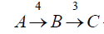
The Product Rule
a) By bus from A to C by way of B;
Solution:
There are 4 ways to go from A to B and 3 ways to go from B to C; hence there are 4 × 3 = 12 ways to go from A to C by way of B.

Slide 78
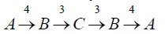
The Product Rule
b) Round trip by bus from A to C by way of B;
Solution:
The person will travel from A to B to C to B to A for the round trip. i.e. (A →B →C →B →A)
The person can travel 4 ways from A to B and 3 way from B to C and back.
Thus there are 4 ×3 ×3 × 4 = 144 ways to travel the round trip.

Slide 79
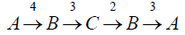
The Product Rule
c) Round trip by bus from A to C by way of B, if the person does not want to use a bus line more than once.
Solution:
The person can travel 4 ways from A to B and 3 ways from B to C, but only 2 ways from C to B and 3 ways from B to A, since bus line cannot be used more than once. Hence there are
4 ×3 ×2 × 3 = 72 ways
to travel the round trip without using a bus line more than once.

Slide 80
The Product Rule
Example: A bit string is a sequence of 0’s and 1’s.How many bit string are there of length 4?
Solution:
Each bit (binary digit) is either 0 or 1.
Hence, there are 2 ways to choose each bit. Since we have to choose four bits therefore,
the product rule shows, there are a total of different bit strings of length four.

Slide 81
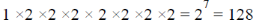
The Product Rule
Example: How many bit strings of length 8:
(i ) begin with a 1?
(ii) begin and end with a 1?
Solution:
(i) If the first bit (left most bit) is a 1, then it can be filled in only one way. Each of the remaining seven positions in the bit string can be filled in 2 ways (i.e., either by 0 or 1). Hence, there are
different bit strings of length 8 that begin with a 1.

Slide 82
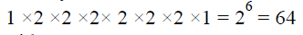
The Product Rule
(ii) begin and end with a 1?
Solution:
If the first and last bit in an 8 bit string is a 1, then only the intermediate six bits can be filled in 2 ways, i.e. by a 0 or 1. Hence there are
different bit strings of length 8 that begin and end with a 1.

Slide 83
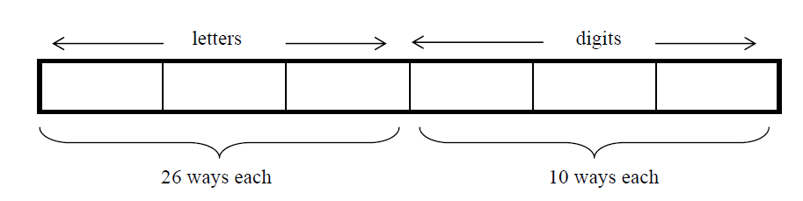
The Product Rule
Example: Suppose that an automobile license plate has three letters followed by three digits.
(a) How many different license plates are possible?
Solution:
Each of the three letters can be written in 26 different ways, and each of the three digits can be written in 10 different ways.
Hence, by the product rule, there is a total of
26 × 26 × 26 × 10 × 10 × 10 = 17,576,000
different License plates possible.

Slide 84
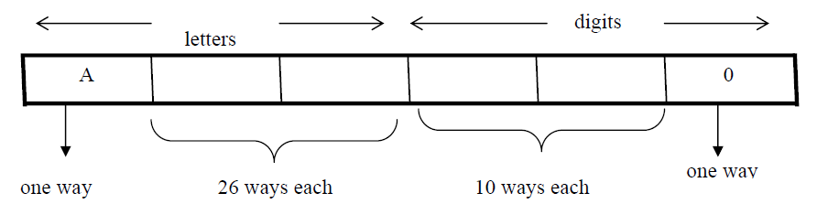
The Product Rule
(b) How many license plates could begin with A and
end on 0?
Solution:
The first and last place can be filled in one way only, while each of second and third place can be filled in 26 ways and each of fourth and fifth place can be filled in 10 ways.
Number of license plates that begin with A and end in 0 are
1 × 26 × 26 × 10 × 10 × 1 = 67600

Slide 85
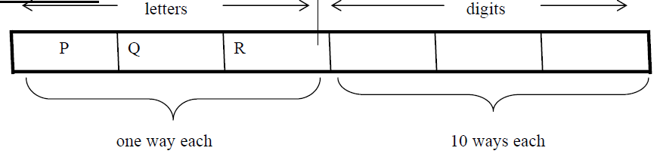
The Product Rule
(c) How many license plates begin with PQR.
Solution:
Number of license plates that begin with PQR are
1 × 1 × 1 × 10 × 10 × 10 = 1000 ways.

Slide 86
The Product Rule
(d) How many license plates are possible in which all the letters and digits are distinct?
Solution:
The first letter place can be filled in 26 ways. Since, the second letter place should contain a different letter than the first, so it can be filled in 25 ways. Similarly, the third letter place can be filled in 24 ways. And the digits can be respectively filled in 10, 9, and 8 ways.
Hence;
number of license plates in which all the letters and digits are distinct are
26 × 25 × 24 × 10 × 9 × 8 = 11, 232, 000

Slide 87
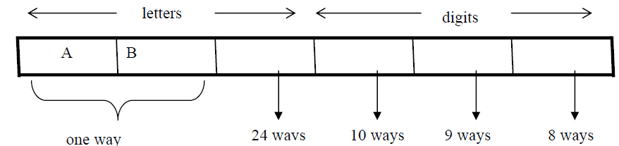
The Product Rule
(e) How many license plates could begin with AB and have all three letters and digits distinct.
Solution:
The first two letters places are fixed (to be filled with A and B), so there is only one way to fill them. The third letter place should contain a letter different from A & B, so there
are 24 ways to fill it.
The three digit positions can be filled in 10 and 8 ways to have distinct digits. Hence, desired number of license plates are
1 × 1 × 24 × 10 × 9 × 8 = 17280

Slide 88
Telephone Numbering Plan
Example: The North American numbering plan (NANP) specifies that a telephone number consists of 10 digits, consisting of a three-digit area code, a three-digit office code, and a four-digit station code. There are some restrictions on the digits.
Let X denote a digit from 0 through 9.
Let N denote a digit from 2 through 9.
Let Y denote a digit that is 0 or 1.
In the old plan (in use in the 1960s) the format was NYX-NNX-XXXX.
In the new plan, the format is NXX-NXX-XXXX.
How many different telephone numbers are possible under the old plan and the new plan?
Solution: Use the Product Rule.
There are 8 ∙2 ∙10 = 160 area codes with the format NYX.
There are 8 ∙10 ∙10 = 800 area codes with the format NXX.
There are 8 ∙8 ∙10 = 640 office codes with the format NNX.
There are 10 ∙10 ∙10 ∙10 = 10,000 station codes with the format XXXX.
Number of old plan telephone numbers: 160 ∙640 ∙10,000 = 1,024,000,000.
Number of new plan telephone numbers: 800 ∙800 ∙10,000 = 6,400,000,000.

Slide 89
NUMBER OF ITERATIONS OF A NESTED LOOP
Example: Determine how many times the inner loop will be iterated when the following algorithm is implemented and run
For i: = 1 to 4
For j : = 1 to 3
[Statement in body of inner loop. None contain branching statements that lead out of the inner loop.]
next j
next i
Solution:
The outer loop is iterated four times, and during each iteration of the outer loop, there are three iterations of the inner loop.
Hence, by product rules
the total number of iterations of inner loop is 4·3=12

Slide 90
Example: Determine how many times the inner loop will be iterated when the following algorithm is implemented and run.
for i = 5 to 50
for j: = 10 to 20
[Statement in body of inner loop. None contain branching statements that lead out of the inner loop.]
next j
next i
Solution:
The outer loop is iterated 50 - 5 + 1 = 46 times and during each iteration of the outer loop there are 20 - 10 + 1 = 11 iterations of the inner loop. Hence by product rule, the total number of iterations of the inner loop is 46×11 = 506.

Slide 91
Example: Determine how many times the inner loop will be iterated when the following algorithm is implemented and run.
for i: = 1 to 4
for j: = 1 to i
[Statements in body of inner loop. None contain branching statements that lead outside the loop.]
next j
next i
Solution:
The outer loop is iterated 4 times, but during each iteration of the outer loop, the inner loop iterates different number of times.
For first iteration of outer loop, inner loop iterates 1 times.
For second iteration of outer loop, inner loop iterates 2 times.
For third iteration of outer loop, inner loop iterates 3 times.
For fourth iteration of outer loop, inner loop iterates 4 times.
Hence, total number of iterations of inner loop = 1 + 2 + 3 + 4 = 10.

Slide 92
Combining the Sum and Product Rule
Example: Suppose statement labels in a programming language can be either a single letter or a letter followed by a digit. Find the number of possible labels.
Solution:
First consider variable names one character in length. Since such names consist of a single letter, there are 26 variable names of length 1.
Next, consider variable names two characters in length. Since the first character is a letter, there are 26 ways to choose it. The second character is a digit, there are 10 ways to choose it. Hence, to construct variable name of two characters in length, there are 26×10 = 260 ways.
Finally, by sum rule, there are 26 + 260 = 286 possible variable names in the programming language.

Slide 93
Counting Passwords
Combining the sum and product rule allows us to solve more complex problems.
Example: Each user on a computer system has a password, which is six to eight characters long, where each character is an uppercase letter or a digit. Each password must contain at least one digit. How many possible passwords are there?
Solution: Let P be the total number of passwords, and let P₆, P₇, and P₈ be the passwords of length 6, 7, and 8.
By the sum rule P = P₆ + P₇ +P₈.
To find each of P₆, P₇, and P₈ , we find the number of passwords of the specified length composed of letters and digits and subtract the number composed only of letters. We find that:
P₆ = 36⁶ − 26⁶ = 2,176,782,336 − 308,915,776 =1,867,866,560.
P₇ = 36⁷ − 26⁷ = 78,364,164,096 − 8,031,810,176 = 70,332,353,920.
P₈ = 36⁸ − 26⁸ = 2,821,109,907,456 − 208,827,064,576 =2,612,282,842,880.
Consequently, P = P₆ + P₇ +P₈ = 2,684,483,063,360.

Slide 94
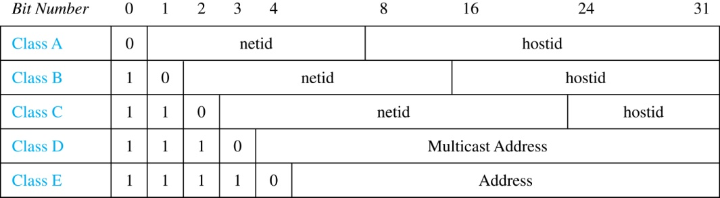
Internet Addresses
Version 4 of the Internet Protocol (IPv4) uses 32 bits.
Class A Addresses: used for the largest networks, a 0,followed by a 7-bit netid and a 24-bit hostid.
Class B Addresses: used for the medium-sized networks, a 10,followed by a 14-bit netid and a 16-bit hostid.
Class C Addresses: used for the smallest networks, a 110,followed by a 21-bit netid and a 8-bit hostid.
Neither Class D nor Class E addresses are assigned as the address of a computer on the internet. Only Classes A, B, and C are available.
1111111 is not available as the netid of a Class A network.
Hostids consisting of all 0s and all 1s are not available in any network.

Slide 95
Counting Internet Addresses
Example: How many different IPv4 addresses are available for computers on the internet?
Solution: Use both the sum and the product rule. Let x be the number of available addresses, and let x_{A}, x_{B}, and x_{C} denote the number of addresses for the respective classes.
To find, x_{A}: 2⁷ − 1 = 127 netids. 2²⁴ − 2 = 16,777,214 hostids.
x_{A} = 127∙ 16,777,214 = 2,130,706,178.
To find, x_{B}: 2¹⁴ = 16,384 netids. 2¹⁶ − 2 = 16,534 hostids.
x_{B} = 16,384 ∙ 16, 534 = 1,073,709,056.
To find, x_{C}: 2²¹ = 2,097,152 netids. 2⁸ − 2 = 254 hostids.
x_{C} = 2,097,152 ∙ 254 = 532,676,608.
Hence, the total number of available IPv4 addresses is
x = x_{A} + x_{B} + x_{C}
= 2,130,706,178 + 1,073,709,056 + 532,676,608
= 3, 737,091,842.
Not Enough Today !!
The newer IPv6 protocol solves the problem of too few addresses.

Slide 96
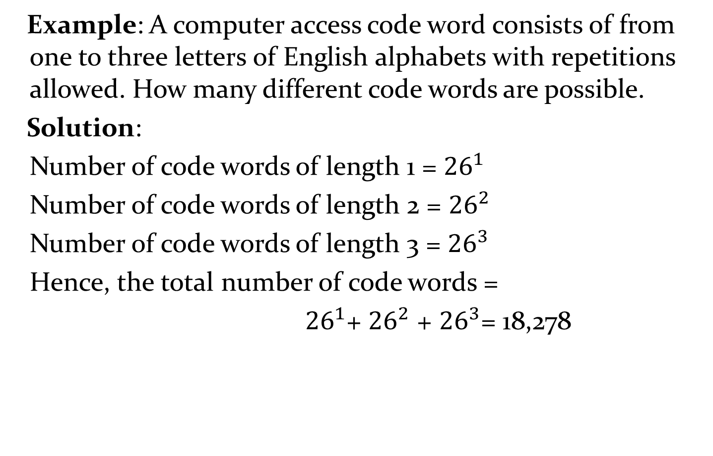
Combining the Sum and Product Rule
Example: A computer access code word consists of from one to three letters of English alphabets with repetitions allowed. How many different code words are possible.
Solution:
Number of code words of length 1 = ${26}^{1}$
Number of code words of length 2 = ${26}^{2}$
Number of code words of length 3 = ${26}^{3}$
Hence, the total number of code words =
${26}^{1}$+ ${26}^{2}$ + ${26}^{3}$= 18,278

Slide 97
Basic Counting Principles: Subtraction Rule
Subtraction Rule: If a task can be done either in one of n₁ ways or in one of n₂ ways, then the total number of ways to do the task is n₁ + n₂ minus the number of ways to do the task that are common to the two different ways.
Also known as, the principle of inclusion-exclusion:

Slide 98

Counting Bit Strings
Example: How many bit strings of length eight either start with a 1 bit and end with the two bits 00?
Solution: Use the subtraction rule.
Number of bit strings of length eight that start with a 1 bit: 2⁷ = 128
Number of bit strings of length eight that start with bits 00: 2⁶ = 64
Number of bit strings of length eight that start with a 1 bit and end with bits 00 : 2⁵ = 32
Hence, the number is 128 + 64 − 32 = 160.

Slide 99
Basic Counting Principles: Division Rule
Division Rule: There are n/d ways to do a task if it can be done using a procedure that can be carried out in n ways, and for every way w, exactly d of the n ways correspond to way w.
Restated in terms of sets: If the finite set A is the union of n pairwise disjoint subsets each with d elements, then n = |A|/d.
In terms of functions: If f is a function from A to B, where both are finite sets, and for every value y ∈ B there are exactly d values x ∈ A such that f(x) = y, then |B| = |A|/d.

Slide 100
Basic Counting Principles: Division Rule
Example: How many ways are there to seat four people around a circular table, where two seating's are considered the same when each person has the same left and right neighbor?
Solution: Number the seats around the table from 1 to 4 proceeding clockwise. There are four ways to select the person for seat 1, 3 for seat 2, 2 for seat 3, and one way for seat 4. Thus there are 4! = 24 ways to order the four people. But since two seating's are the same when each person has the same left and right neighbor, for every choice for seat 1, we get the same seating.
Therefore, by the division rule, there are 24/4 = 6 different seating arrangements.

Slide 101
Counting Functions
Counting Functions: How many functions are there from a set with m elements to a set with n elements?
Solution: Since a function represents a choice of one of the n elements of the codomain for each of the m elements in the domain, the product rule tells us that there are n ∙ n ∙ ∙ ∙ n = n^{m} such functions.
Counting One-to-One Functions: How many one-to-one functions are there from a set with m elements to one with n elements?
Solution: Suppose the elements in the domain are a₁, a₂,…, a_{m}. There are n ways to choose the value of a₁ and n−1 ways to choose a₂, etc. The product rule tells us that there are n(n−1) (n−2)∙∙∙(n−m +1) such functions.

Slide 102
Tree Diagrams
Tree Diagrams: We can solve many counting problems through the use of tree diagrams, where a branch represents a possible choice and the leaves represent possible outcomes.
Example: Suppose that “I Love Discrete Math” T-shirts come in five different sizes: S,M,L,XL, and XXL. Each size comes in four colors (white, red, green, and black), except XL, which comes only in red, green, and black, and XXL, which comes only in green and black. What is the minimum number of stores that the campus book store needs to stock to have one of each size and color available?

Slide 103

Tree Diagrams
Solution: Draw the tree diagram.
The store must stock 17 T-shirts.

Slide 104
The Pigeonhole Principle
Section 6.2

Slide 105
Section Summary
The Pigeonhole Principle
The Generalized Pigeonhole Principle

Slide 106
The Pigeonhole Principle
Pigeonhole Principle: If k is a positive integer and k + 1 objects are placed into k boxes, then at least one box contains two or more objects.
Proof: We use a proof by contraposition. Suppose none of the k boxes has more than one object. Then the total number of objects would be at most k. This contradicts the statement that we have k + 1 objects.

Slide 107

The Pigeonhole Principle
If a flock of 20 pigeons roosts in a set of 19 pigeonholes, one of the pigeonholes must have more than 1 pigeon.

Slide 108
The Pigeonhole Principle
Corollary 1: A function f from a set with k + 1 elements to a set with k elements is not one-to-one.
Proof: Use the pigeonhole principle.
Create a box for each element y in the codomain of f .
Put in the box for y all of the elements x from the domain such that f(x) = y.
Because there are k + 1 elements and only k boxes, at least one box has two or more elements.
Hence, f can’t be one-to-one.

Slide 109
Pigeonhole Principle
Example: Among any group of 367 people, there must be at least two with the same birthday, because there are only 366 possible birthdays. ⌈367/366⌉ = 2
Example: Among 100 people there are at least ⌈100/12⌉ = 9 who were born in the same month.
Example: In any set of 27 English , must be at least two that begin with the same letter, since there are 26 letters in the English alphabet. ⌈27/26⌉ = 2

Slide 110

The Generalized Pigeonhole Principle
The Generalized Pigeonhole Principle: If N objects are placed into k boxes, then there is at least one box containing at least ⌈N/k⌉ objects.
Proof: We use a proof by contraposition. Suppose that none of the boxes contains more than ⌈N/k⌉ − 1 objects. Then the total number of objects is at most
where the inequality ⌈N/k⌉ < ⌈N/k⌉ + 1 has been used. This is a contradiction because there are a total of n objects.

Slide 111
The Generalized Pigeonhole Principle
Example: What is the minimum number of students required in a Discrete Mathematics class to be sure that at least six will receive the same grade, if there are five possible grades, A, B, C, D, and F.
Solution:
The minimum number of students needed to guarantee that at least six students receive the same grade is the smallest integer N such that ⌈ N/K ⌉ = ⌈ N/5 ⌉ = 6. The smallest such integer is
N = K(⌈ N/K ⌉-1)+1 = 5(6-1)+1=5 ⋅ 5 + 1 = 26.
Thus 26 is the minimum number of students needed to be sure that at least 6 students will receive the same grades.

Slide 112
Permutations and Combinations
Section 6.3

Slide 113
Section Summary
Permutations
Combinations
Combinatorial Proofs

Slide 114
Permutations
Definition: A permutation of a set of distinct objects is an ordered arrangement of these objects. An ordered arrangement of r elements of a set is called an r-permutation.
Example: Let S = {1,2,3}.
The ordered arrangement 3,1,2 is a permutation of S.
The ordered arrangement 3,2 is a 2-permutation of S.
The number of r-permutations of a set with n elements is denoted by P(n,r).
The 2-permutations of S = {1,2,3} are 1,2; 1,3; 2,1; 2,3; 3,1; and 3,2. Hence, P(3,2) = 6.

Slide 115

A Formula for the Number of Permutations
Theorem 1: If n is a positive integer and r is an integer with 1 ≤ r ≤ n, then there are
P(n, r) = n(n − 1)(n − 2) ∙∙∙ (n − r + 1)
r-permutations of a set with n distinct elements.
Proof: Use the product rule. The first element can be chosen in n ways. The second in n − 1 ways, and so on until there are (n − ( r − 1)) ways to choose the last element.
Note that P(n,0) = 1, since there is only one way to order zero elements.
Corollary 1: If n and r are integers with 1 ≤ r ≤ n, then

Slide 116
Solving Counting Problems by Counting Permutations
Example: How many ways are there to select a first-prize winner, a second prize winner, and a third-prize winner from 100 different people who have entered a contest?
Solution:
P(100,3) = 100 ∙ 99 ∙ 98 = 970,200

Slide 117
Solving Counting Problems by Counting Permutations (continued)
Example: Suppose that there are eight runners in a race. The winner receives a gold medal, the second place finisher receives a silver medal, and the third-place finisher receives a bronze medal. How many different ways are there to award these medals, if all possible outcomes of the race can occur and there are no ties?
Solution: The number of different ways to award the medals is the number of 3-permutations of a set with eight elements. Hence, there are P(8, 3) = 8 · 7 · 6 = 336 possible ways to award the medals.

Slide 118
Solving Counting Problems by Counting Permutations (continued)
Example: Suppose that a saleswoman has to visit eight different cities. She must begin her trip in a specified city, but she can visit the other seven cities in any order she wishes. How many possible orders can the saleswoman use when visiting these cities?
Solution: The first city is chosen, and the rest are ordered arbitrarily. Hence the orders are:
7! = 7 ∙ 6 ∙ 5 ∙ 4 ∙ 3 ∙ 2 ∙ 1 = 5040
If she wants to find the tour with the shortest path that visits all the cities, she must consider 5040 paths!

Slide 119
Solving Counting Problems by Counting Permutations (continued)
Example: How many permutations of the letters ABCDEFGH contain the string ABC ?
Solution: We solve this problem by counting the permutations of six objects, ABC, D, E, F, G, and H.
6! = 6 ∙ 5 ∙ 4 ∙ 3 ∙ 2 ∙ 1 = 720

Slide 120

Combinations
Definition: An r-combination of elements of a set is an unordered selection of r elements from the set. Thus, an r-combination is simply a subset of the set with r elements.
The number of r-combinations of a set with n distinct elements is denoted by C(n, r).
The notation is also used and is called a binomial coefficient. (We will see the notation again in the binomial theorem in Section. 6.4)

Slide 121
Combinations
Example:
Let S be the set {a, b, c, d}. Then {a, c, d} is a 3-combination from S. It is the same as {d, c, a} since the order listed does not matter.
C(4,2) = 6 because the 2-combinations of {a, b, c, d} are the six subsets {a, b}, {a, c}, {a, d}, {b, c}, {b, d}, and {c, d}.

Slide 122

Combinations
Theorem 2: The number of r-combinations of a set with n elements, where n ≥ r ≥ 0, equals
Proof: By the product rule P(n, r) = C(n,r) ∙ P(r,r). Therefore,

Slide 123

Combinations
Example: How many poker hands of five cards can be dealt from a standard deck of 52 cards? Also, how many ways are there to select 47 cards from a deck of 52 cards?
Solution: Since the order in which the cards are dealt does not matter, the number of five card hands is:
The different ways to select 47 cards from 52 is
This is a special case of a general result. →

Slide 124

Combinations
Corollary 2: Let n and r be nonnegative integers with r ≤ n. Then C(n, r) = C(n, n − r).
Proof: From Theorem 2, it follows that
and
Hence, C(n, r) = C(n, n − r).
This result can be proved without using algebraic manipulation. →

Slide 125
Combinatorial Proofs
Definition 1: A combinatorial proof of an identity is a proof that uses one of the following methods.
A double counting proof uses counting arguments to prove that both sides of an identity count the same objects, but in different ways.
A bijective proof shows that there is a bijection between the sets of objects counted by the two sides of the identity.

Slide 126

Combinatorial Proofs
Here are two combinatorial proofs that
C(n, r) = C(n, n − r)
when r and n are nonnegative integers with r < n:
Bijective Proof: Suppose that S is a set with n elements. The function that maps a subset A of S to is a bijection between the subsets of S with r elements and the subsets with n − r elements. Since there is a bijection between the two sets, they must have the same number of elements.
Double Counting Proof: By definition the number of subsets of S with r elements is C(n, r). Each subset A of S can also be described by specifying which elements are not in A, i.e., those which are in . Since the complement of a subset of S with r elements has n − r elements, there are also C(n, n − r) subsets of S with r elements.

Slide 127

Combinations
Example: How many ways are there to select five players from a 10-member tennis team to make a trip to a match at another school.
Solution: By Theorem 2, the number of combinations is
Example: A group of 30 people have been trained as astronauts to go on the first mission to Mars. How many ways are there to select a crew of six people to go on this mission?
Solution: By Theorem 2, the number of possible crews is

Slide 128
Binomial Coefficients and Identities
Section 6.4

Slide 129
Section Summary
The Binomial Theorem
Pascal’s Identity and Triangle

Slide 130


Binomial Theorem
Binomial Theorem: Let x and y be variables, and n a nonnegative integer. Then:
Proof: We use combinatorial reasoning . The terms in the expansion of (x + y)^{n} are of the form x^{n−j}y^{j} for j = 0,1,2,…,n. To form the term x^{n−j}y^{j}, it is necessary to choose n−j xs from the n sums. Therefore, the coefficient of x^{n−j}y^{j} is which equals .

Slide 131


Powers of Binomial Expressions
Definition: A binomial expression is the sum of two terms, such as x + y. (More generally, these terms can be products of constants and variables.)
We can use counting principles to find the coefficients in the expansion of (x + y)^{n} where n is a positive integer.
To illustrate this idea, we first look at the process of expanding (x + y)³.
(x + y) (x + y) (x + y) expands into a sum of terms that are the product of a term from each of the three sums.
Terms of the form x³, x²y, x y², y³ arise. The question is what are the coefficients?
To obtain x³ , an x must be chosen from each of the sums. There is only one way to do this. So, the coefficient of x³ is 1.
To obtain x²y, an x must be chosen from two of the sums and a y from the other. There are ways to do this and so the coefficient of x²y is 3.
To obtain xy², an x must be chosen from of the sums and a y from the other two . There are ways to do this and so the coefficient of xy² is 3.
To obtain y³ , a y must be chosen from each of the sums. There is only one way to do this. So, the coefficient of y³ is 1.
We have used a counting argument to show that (x + y)³ = x³ + 3x²y + 3x y² + y³ .
Next we present the binomial theorem gives the coefficients of the terms in the expansion of (x + y)^{n} .

Slide 132

Using the Binomial Theorem
Example:

Slide 133

Using the Binomial Theorem

Slide 134


Using the Binomial Theorem
Example: What is the coefficient of x¹²y¹³ in the expansion of (2x − 3y)²⁵?
Solution: We view the expression as (2x +(−3y))²⁵. By the binomial theorem
Consequently, the coefficient of x¹²y¹³ in the expansion is obtained when j = 13.

Slide 135







A Useful Identity
Corollary 1: With n ≥0,
Proof (using binomial theorem): With x = 1 and y = 1, from the binomial theorem we see that:
Proof (combinatorial): Consider the subsets of a set with n elements. There are subsets with zero elements, with one element, with two elements, …, and with n elements. Therefore the total is
Since, we know that a set with n elements has 2^{n} subsets, we conclude:

Slide 136





Pascal’s Identity
Blaise Pascal
(1623-1662)
Pascal’s Identity: If n and k are integers with n ≥ k ≥ 0, then
Proof (combinatorial): Let T be a set where |T| = n + 1, a ∊T, and S = T − {a}. There are subsets of T containing k elements. Each of these subsets either:
contains a with k − 1 other elements, or
contains k elements of S and not a.
There are
subsets of k elements that contain a, since there are subsets of k − 1 elements of S,
subsets of k elements of T that do not contain a, because there are subsets of k elements of S.
Hence,
See Exercise 19 for an algebraic proof.

Slide 137

Pascal’s Triangle
The nth row in the triangle consists of the binomial coefficients ,
k = 0,1,….,n.
By Pascal’s identity, adding two adjacent bionomial coefficients results is the binomial coefficient in the next row between these two coefficients.

Slide 138
The Foundations: Logic and Proofs
Chapter 1, Part VII: Introduction to Proofs .

Slide 139
Proofs
A proof is a valid argument that establishes the truth of a mathematical statement.
Ingredients:
hypotheses of the theorem
axioms assumed to be true
previously proven theorems
rules of inference
You get:
truth of the
statement
being proved

Slide 140
Usefulness
Computer Science
Verifying that computer programs are correct.
Establishing that operating systems are secure.
Making inferences in artificial intelligence.
Showing that system specifications are consistent.
Mathematics
Defining Formalism.
Providing specification in a common language.
Justification for the results.

Slide 141

Activity Time
Have you seen any Proof before?

Slide 142
Proofs
Formal proofs
all steps were supplied
rules for each step in the argument were given
Usefulness: Automated Reasoning Systems.
Informal Proofs
more than 1 rule of inference may be used per step
where steps may be skipped,
where the axioms being assumed
rules of inference used are not explicitly stated
Usefulness: Designed For Human Consumption.

Slide 143
Terminology
Theorem is a mathematical statement that is true and can be (and has been) verified as true.
Less important theorems sometimes are called propositions, facts or results.
A proof is a valid argument that establishes the truth of a theorem or written verification of a theorem.
Axioms (or postulates) are assumed to be true
Axioms may be stated using primitive terms that do not require definition, but all other terms used in theorems and their proofs must be defined.
A definition is an exact, unambiguous explanation of the meaning of a mathematical word or phrase.
e.g: N, W, R, Q , Φ , ∞ etc.

Slide 144
Terminology
A less important theorem that is helpful in the proof of other results or theorem is called a lemma
(plural lemmas or lemmata).
A corollary is a result or a theorem that is an immediate consequence/result of a theorem or proposition.
A conjecture is a statement that is being proposed to be a true statement.
If it can be proved, it’s a theorem.
Not a theorem, if it cannot be proved.
Is a false proposition not a theorem?

Slide 145
Activity Time
Give an Example of Theorem

Slide 146

Solution
If a series is absolutely convergent, then it is convergent.
If P then Q form – conditional statement form

Slide 147
Definitions
An integer n is even if n = 2a for some integer aЄZ.
An integer n is odd if n = 2a+1 for some integer aЄZ.
Is 5 or 10 even or odd ?
Two integers have the same parity if they are both even or they are both odd. Otherwise they have opposite parity.
Is 5 and -17 has same parity and what about 3 and 4?

Slide 148
Definitions
Suppose a and b are integers. We say that a divides b, written a|b, if b=ac for some c Є Z.
a is a divisor of b, and that b is a multiple of a.
5|15 , 3|15 , 15|3 , -6|6 etc.
The expression a|b is a statement, while a/b is a fraction.
For example, 8|16 is true and 8|20 is false.
By contrast, 8/16 = 0.5 and 8/20 = 0.4 are numbers, not statements.

Slide 149
Activity Time
Write Definition for Prime Numbers?
Is 1 a prime number ?

Slide 150

Set of divisors

Slide 151
Definitions
An integer n is composite if it factors as n = ab where a,b > 1.
The greatest common divisor of integers a and b, denoted gcd(a,b), is the largest integer that divides both a and b and anyone of them must be non-zero.
gcd(18,24), gcd(5,5), gcd(32,-8), gcd(50,18)
gcd(50,9) =1 , gcd(0,6) = 6, gcd(0,0) = ∞ why?? , which condition of gcd solves this problem.
The least common multiple of non-zero integers a and b, denoted lcm(a,b), is smallest positive integer that is a multiple of both a and b.
lcm(4,6) = 12, and lcm(7,7) = 7

Slide 152

FACTS
Some statements are accepted without justification.
Note that we will always MENTION the axioms found in Appendix 1 of Rosen. When you construct your own proofs, be careful NOT to use anything but these axioms, definitions, and previously proved results (BY YOU) as facts!

Slide 153
Types of Proofs
Proving conditional Statements
Direct Proofs
Indirect Proofs
Proof by Contraposition
Proofs by Contradiction
Proving Non-conditional Statements
Indirect Proofs
If-And-Only-If Proof
Constructive Versus Non-constructive Proofs
Existence Proofs; Existence and Uniqueness Proofs
Disproofs (Counterexample, Contradiction, Existence Statement)
Proofs Involving Sets
Mathematical Induction

Slide 154

Direct Proofs
p →q
first step is the assumption that p is true
subsequent steps constructed using rules of inference.
final step showing that q must also be true
showing that if p is true,
then q must also be true,
so that the combination
p true and q false never occurs

Slide 155
“If n is an odd integer, then n² is odd.”
P(n) is “n is an odd integer”
Q(n) is “n² is odd.”
∀n (P(n) → Q(n)) : n belongs to set of integers
We will prove P(c) → Q(c) for any arbitrary c

Slide 156
Definition of odd and even integers
The integer n is even
if there exists an integer k such that n = 2k
The integer n is odd
if there exists an integer k such that n = 2k + 1.
Note that every integer is either even or odd, and no integer is both even and odd.

Slide 157
Proof
We assume that the hypothesis of this conditional statement is true, namely, we assume that n is odd.
By the definition of an odd integer, it follows that n = 2k + 1, where k is some integer.
Square both sides n² = (2k + 1)²
4k² + 4k + 1 = 2(2k² + 2k) + 1.
Consequently, we have proved that if n is an odd integer, then n² is an odd integer

Slide 158


Slide 159

Example

Slide 160

Example

Slide 161
Activity Time
Give a direct proof that if m and n are both perfect squares, then nm is also a perfect square.

Slide 162
Proof
We assume that the hypothesis of this conditional statement is true, namely, we assume that m and n are both perfect squares.
By the definition of a perfect square, It follows that there are integers s and t such that m = s² and n = t².
Multiplying both m and n to get s²t².
Hence, mn = s²t² = (ss)(tt) = (st)(st) = (st)², using commutativity and associativity of multiplication.
By the definition of perfect square, it follows that mn is also a perfect square, because it is the square of st, which is an integer.
We have proved that if m and n are both perfect squares, then mn is also a perfect square.

Slide 163
Activity Time
Give a direct proof that if n is an integer and 3n + 2 is odd, then n is odd.

Slide 164
Indirect Proofs
Direct proof begin with the premises, continue with a sequence of deductions, and end with the conclusion.
Attempts at direct proofs often reach dead ends
Proofs that do not start with the premises and end with the conclusion, are called indirect proofs

Slide 165

Proof by Contraposition
p → q is equivalent to ￢q →￢p
Take ￢q as a premise, and using axioms, definitions, and previously proven theorems, together with rules of inference, we show that ￢p must follow.

Slide 166
Prove that if n is an integer and 3n + 2 is odd, then n is odd.
Assume that the conclusion of the conditional statement is false; namely, assume that n is even.
By the definition of an even integer, n = 2k for some integer k.
Substituting 2k for n, we find that 3n + 2 = 3(2k) + 2 = 6k + 2 = 2(3k + 1). This tells us that 3n + 2 is even (because it is a multiple of 2), and therefore not odd.
This is the negation of the premise of the theorem.
Hence Proved.

Slide 167
Activity Time
Show that at least four of any 22 days must fall on the same day-of-the-week (Sun - Sat)
Next: Proof by Contradiction

Slide 168

Old Activity
Write a tautology & contradiction, using one propositional variable
p ∨¬p is always true, it is a tautology.
p ∧¬p is always false, it is a contradiction.

Slide 169
Proofs by Contradiction
Suppose we want to prove that a statement p is true.
Furthermore, suppose that we can find a contradiction c such that ￢p → c is true.
Since c is false, but ￢p → c is true, we can conclude that ￢p is false, which means that p is true.
Any statement that leads to a contradictory statement cannot be true.

Slide 170
Proof Methodology
How can we find a contradiction q that might help us prove that p is true in this way?
Because the statement c:(r ∧￢r) is a contradiction whenever r is a proposition, we can prove that p is true if we can show that ￢p → (r ∧￢r) is true for some proposition r.

Slide 171
a² - 4b <> 2: a,b є Z
Suppose FOR SAKE OF CONTRADICTION this proposition is false.
So there exist Integers a, b : a² - 4b = 2.
a² = 2 + 4b = 2(2b + 1) so a² is even.
Even * Even = Even. So a is even a = 2c.
(2c)² – 4b = 2, so 2c² – 2b = 1
Or 1 = 2(c² – b), so 1 is even.
p: (1 is odd) ^ (1 is even). p is a contradiction.

Slide 172

Truth Table

Slide 173

Basic Idea
Assume that the statement we want to prove is false, and then show that this assumption leads to nonsense!
We are then led to
conclude that we were
wrong to assume the
statement was false,
so the statement must be true.

Slide 174
Example
Theorem: is not rational
Proof:
Assume for the sake of contradiction that it is rational
= n/m
n and m have no common factors
We will show that this is impossible

Slide 175
= n/m 2 m² = n²
n is even
n = 2 k
Therefore, n² is even
m is even
m = 2 p
2 m² = 4k²
m² = 2k²
Thus, m and n have common factor 2
Contradiction!

Slide 176
Show that at least four of any 22 days must fall on the same day of the week
Let p be the proposition “At least four of 22 chosen days fall on the same day of the week.” Suppose that ￢p is true.
This means that at most three of the 22 days fall on the same day of the week.
Because there are seven days of the week, this implies that at most 21 days could have been chosen, as for each of the days of the week, at most three of the chosen days could fall on that day.
This contradicts the premise that we have 22 days under consideration

Slide 177
Activity Time
How can we use Proof by Contradiction to prove a conditional statement is true?
logical equivalence of r and s, r:p → q and s:(p ∧￢q) → F

Slide 178

Proof by Contradiction (Conditional Statements)
Proof by contradiction begins with the assumption that ￢(p→ q) is true,
OR that p→ q is false.
We know that p→ q is false, means that it is possible that P can be true while Q is false.
Thus the first step
in the proof is to
assume P and￢ Q.

Slide 179
Proof: If a² is even, then a is even.
For the sake of contradiction, suppose:
a² is even and a is not even.
So a² is even, and a is odd.
Since a is odd, there is an integer c : a = 2c + 1.
Then a² = (2c + 1)² = 4c² + 4c + 1 = 2(2c²+2c)+1
So a² is odd
Thus a² is even and a² is not even
Contradiction.

Slide 180
Activity Time
How is Proof by Contradiction and Proof by Contraposition (logically) similar and different?

Slide 181
Proof by Contradiction (Conditional Statements)
To rewrite a proof by contraposition of p → q as a proof by contradiction, we suppose that both p and ￢q are true.
Then, we use the steps from the proof of ￢q →￢p to show that ￢p is true.
This may lead to the contradiction p ∧￢p

Slide 182
Activity Time
How is Proof by Contradiction and Direct proof (logically) similar and different?

Slide 183
Proof by Contradiction (Conditional Statements)
To rewrite a Direct Proof of p → q as a proof by contradiction, we suppose that both p and ￢q are true.
Then, we use the steps from the proof of p → q to show that q is true.
This may lead to the contradiction q ∧￢q

Slide 184

Combining Techniques
Proofs inside of proofs
Proposition Every non-zero rational number can be expressed as a product of two irrational numbers.

Slide 185

When to use what?

Slide 186

Mistakes in Proofs

Slide 187

Mistakes in Proofs

Slide 188


Mistakes in Proofs

Slide 189


Mistakes in Proofs

Slide 190
Proof in Sets

Slide 191
Objectives
How to show that an object is an element of a set?
How to prove one set is a subset of another and
How to prove two sets are equal

Slide 192

Some definitions
If A and B are sets, then:

Slide 193


Proof that a Є A
x could be any kind of object (integer, ordered pair, set, function, etc.)

Slide 194

Examples

Slide 195

Examples

Slide 196



Slide 197


Slide 198


Slide 199


Slide 200


Slide 201

Prove that A=B

Slide 202


Slide 203
Discrete Probability

Slide 204

Probability
The probability of an event occurring is a number between 0 and 1, and represents essentially how often that event occurs. For example:
The probability of flipping a coin and it landing on heads is ½.
The probability of rolling a 6-sided die and getting the number 3 is 1/6.
Sample Space: A sample space is the set of all possible outcomes of a random process.
Event: An event is a subset of the sample space.
In “Discrete Probability”, we focus on finite and countable sample spaces.

Slide 205


An event may contain one, many, all or none of the sample points in U.

Slide 206


Slide 207


The collection of all events is non-empty and satisfies the following:
Example, let U be the sample space of all sequences of three coin tosses described above, and consider the following events:

Slide 208



Slide 209



Slide 210


Slide 211


Slide 212


Slide 213


Slide 214


Slide 215


Slide 216

Example

Slide 217


Slide 218


Slide 219



Slide 220


Slide 221


Slide 222


Slide 223


Slide 224


Slide 225

Variables
A variable is a characteristic or attribute that can assume different values.
A random variable is a variable whose values are determined by chance.
Discrete variables are countable.
Example: Roll a die and let X represent the outcome
so X = {1,2,3,4,5,6}

Slide 226



Slide 227


Slide 228



Slide 229
Mathematical Induction
Shoaib Raza

Slide 230

Conjecture: The sum of the first n odd natural numbers equals n².

Slide 231
An infinite ladder
Suppose that we have an infinite ladder, and we want to know whether we can reach every step on this ladder.
We know two things:
1. We can reach the first rung of the ladder.
2. If we can reach a particular rung of the ladder, then we can reach the next rung.

Slide 232


Slide 233
Mathematical Induction
Mathematical statements assert that a property is true for all positive integers.
Proofs using mathematical induction have two parts.
First, they show that the statement holds for the positive integer 1 (base case).
Second, they show that if the statement holds for a positive integer then it must also hold for the next larger integer. (inductive case)
The method can be extended to prove statements about more general well-founded structures, such as trees; this generalization, known as structural induction, is used in mathematical logic and computer science.

Slide 234


Exhaustive Proof?
Direct Proof?

Slide 235
NOTE
It is extremely important to note that mathematical induction can be used only to prove results obtained in some other way.
It is not a tool for discovering formulae or theorems.
Mathematicians sometimes find proofs by mathematical induction unsatisfying because they do not provide insights as to why theorems are true.
You can prove a theorem by mathematical induction even if you do not have the slightest idea why it is true!

Slide 236
Validity of Proof by Induction
Mathematical induction is based on the rule of inference that tells us that
if P(1) and ∀k(P(k) → P(k + 1)) are true for the domain of positive integers,
then ∀n P(n) is true.
P(1) is true ∀k≥1 (P(k)→P(k+1)) is true
----------------- ∴∀n≥1 P(n)
universal modus ponens?
www.cse.unr.edu/~bebis/CS365/Lect/Induction.ppt

Slide 237
Validity of Proof by Induction
Prove: if P(1) ∧ ∀k≥1 (P(k)→P(k+1)), then ∀n≥1 P(n)
(a) Given any n≥1, ∀k≥1 (P(k)→P(k+1)) implies
(P(1)→P(2)) ∧ (P(2)→P(3)) ∧ … ∧ (P(n−1)→P(n))
(b) Using hypothetical syllogism n-1 times we have
P(1)→P(n)
(c) P(1) and modus ponens gives P(n).
Thus ∀n≥1 P(n).
P(k + 1) cannot be false when P(k) is true.
www.cse.unr.edu/~bebis/CS365/Lect/Induction.ppt

Slide 238


Slide 239


Slide 240
Reasoning (Philosophy)
Deductive reasoning
"top-down" logic
Specific examples are derived from general propositions.
Process of reasoning from one or more general statements (premises) to reach a logically certain conclusion.
Mathematical proofs rely heavily on deductive reasoning
Inductive reasoning
"bottom-up" logic
Evaluates general propositions that are derived from specific examples.
Allows for the possibility that the conclusion is false, even if all of the premises are true.

Slide 241
Activity Time
Is “Proof by Induction” based on
Inductive reasoning or deductive reasoning.
Answer: Deductive reasoning.

Slide 242







Slide 243



Slide 244







Slide 245


Slide 246


Slide 247
Activity Time
Is induction same as recursion?

Slide 248
Remark
Recursion is another thing
Example of recursive function:
f(n) = f(n-1) + f(n-2)
f(0) = 1, f(1) = 1

